Slide 1
Department of Computer Science & Business Systems SUBJECT: Usability Design of Software Applications Subject Code: Topic Name: Usability Design of Software Applications IV year, Sec: A
Vallurupalli Nageswara Rao Vignana Jyothi Institute of Engineering &Technology
Bhagya Rekha Konkepudi
Assistant Professor
Email: bhagyarekha_k@vnrvjiet.in
<Web link of your created resource if any>

Slide 2
Agenda
Introduction to User-Centred Design:
Basics of User-Centered Design
Aspects of User-Centred Design:
Product Appreciation Assignment

Slide 3
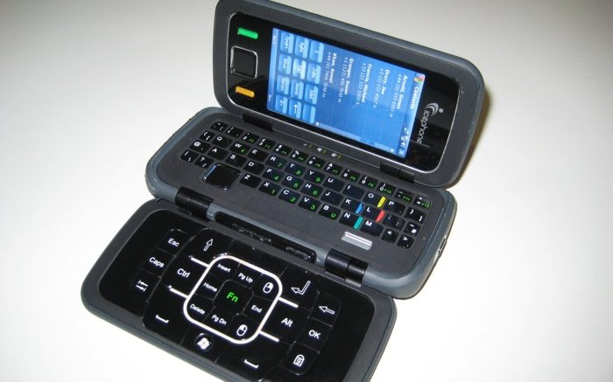
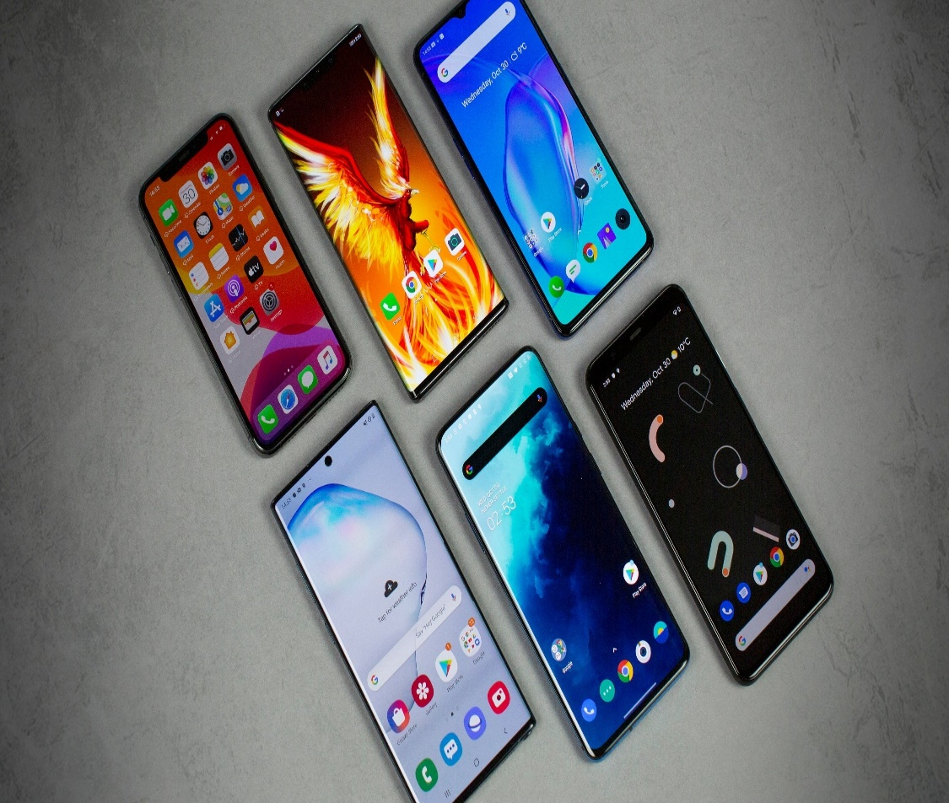
Which phone do you Prefer ???
Old phones prioritized buttons and durability. Modern phones prioritize usability, touch interfaces, camera quality, and seamless user experience — all outcomes of UCD.

Slide 4
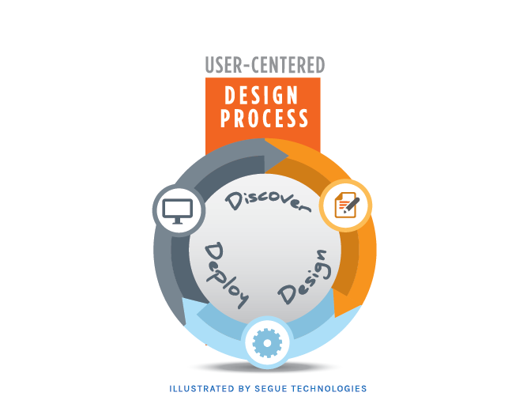
What is User Centered Design?
UCD is about designing with the user in mind, not just what the system can do, but how users feel using it.
The practice of creating engaging, efficient user experiences is called user-centered design.
The concept of user-centered design is very simple: Take the user into account every step of the way as you develop your product. The implications of this simple concept, however, are surprisingly complex.
"User-Centered Design (UCD) is a user interface design process that focuses on usability goals, user characteristics, environment, tasks, and workflow in the design of an interface.
UCD follows a series of well-defined methods and techniques for the analysis, design, and evaluation of mainstream hardware, software, and web interfaces.
The UCD process is an iterative process, where design and evaluation steps are built in from the first stage of projects, through implementation."
(Shawn Lawton Henry and Mary Martinson, Accessibility in User-Centered Design)
Putting Users at the Heart of the Design

Slide 5
UCD Principles
Early focus on users and tasks
Structured and systematic information gathering (consistent across the board)
Designers trained by experts before conducting data collection sessions.
Use personas and scenarios early in the design.
Example: Netflix uses viewing behavior to personalize recommendations.
Empirical Measurement and testing of product usage
Focus on ease of learning and ease of use.
Testing of prototypes with actual users.
Use A/B testing, usability metrics like task completion time, error rate.
Example: Amazon constantly tests UI layouts to improve checkout experience.
Iterative Design
Product designed, modified and tested repeatedly.
Allow for the complete overhaul and rethinking of design by early testing of conceptual models and design ideas.
Feedback loops help identify UX flaws quickly.
Example: Instagram Reels feature was refined post user feedback during beta release.

Slide 6
What is the difference between software engineering and interaction design ??

Slide 7




What is the difference between software engineering and interaction design ??

Slide 8
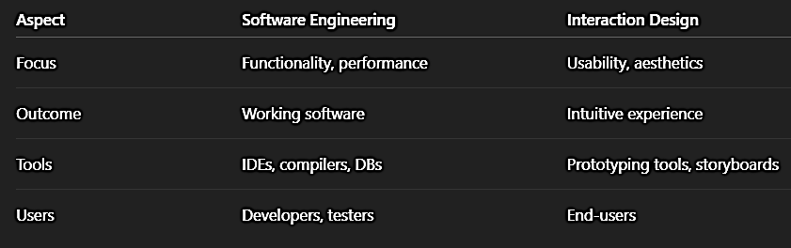
What is the difference between software engineering and interaction design ??

Slide 9
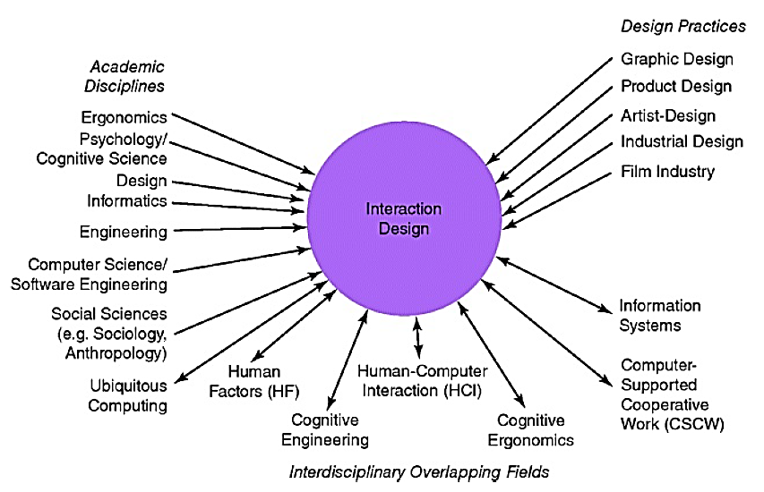
The Components of Interaction Design
Current trends in components:
AI Integration – Smart assistants like Siri, Alexa.
AR/VR – Used in IKEA app to place furniture virtually.
Emotional Design – Apps like Calm focus on mood-based design.
Examples to Fields:
Ergonomics → Mobile grip and screen size.
HCI → Voice-activated systems.
Social Science → TikTok's viral design tapping into psychology.
Figure 1.4 Relationship among contributing academic disciplines,
design practices, and interdisciplinary fields concerned with
interaction design (double-headed arrows mean overlapping)

Slide 10
Who Is Involved in Interaction Design?
Interaction design is a collaborative effort involving multidisciplinary teams.
Includes a mix of professionals:
Engineers, Programmers, UX/UI Designers
Psychologists, Sociologists, Anthropologists
Artists, Toy Makers, Accessibility Experts
UX Researchers – gather insights via interviews, usability tests
UI Designers – craft interfaces using tools like Figma, Adobe XD
Accessibility Experts – ensure inclusivity for all users
Team composition depends on: Product type, target audience, company philosophy, and scale.

Slide 11
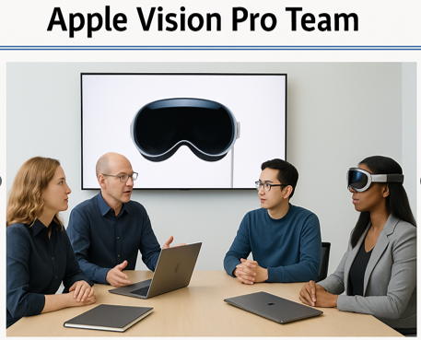

Who Is Involved in Interaction Design? (Contd..)
Benefits of diversity in teams:
Broader idea generation
Unique problem-solving approaches
More creative and user-centered designs
Real-World Examples:
The Apple Vision Pro team is a multidisciplinary group at Apple that developed the Apple Vision Pro, Apple’s first spatial computing headset, launched in 2023..
The Google Search UX (User Experience) Team is a multidisciplinary group responsible for making search intuitive, fast, and helpful.

Slide 12
Interaction Design Consultants
Interaction design is now widespread in product development. Website consultants, global corporations, and the computing industry have realized their pivotal role in creating successful interactive products. The presence or absence of good interaction design can make or break a company.
In today’s competitive market, a product that is easy, effective, and engaging to use is considered a key advantage. It affects branding, website hits, customer retention, and satisfaction.
Well-known interaction design consultancies include:
IDEO – A global leader in design with 30+ years of experience. Known for the Apple mouse, TiVo system, Palm V, and AT&T platforms.
Nielsen Norman Group – Experts in usability and user research.
Cooper – Pioneered persona-based design.
CXpartners – Specializes in mobile UX and service design.
Madgex – Focuses on job board software UX.
These companies create innovative products, services, and experiences across multiple domains.
Example: IDEO designed the first Apple mouse, Palm V, and the AT&T integrated service platform. Recently, they’ve been involved in climate-focused solutions such as sustainable system design.

Slide 13
Interaction Design Consultants
Interaction design is now widespread in product development. Website consultants, global corporations, and the computing industries have all realized their pivotal role in successful interactive products. The presence or absence of good interaction design can make or break a company. To get noticed in the highly competitive field of web products requires standing out.
Being able to say that your product is easy, effective, and engaging to use is seen as central to this. Marketing departments are also realizing how branding, the number of hits, customer return rate, and customer satisfaction are greatly affected by the usability of a website.
There are many interaction design consultancies now. These include established companies, such as Cooper, Nielsen Norman Group, and IDEO, and more recent ones that specialize in a particular area, such as job board software (e.g. Madgex) or mobile design (e.g. CXpartners). IDEO is a large global enterprise, with branches across the world and 30 years of experience in the area. They design products, services, and environments for other companies, pioneering new user experiences (Spreen berg et al, 1995).
They have developed thousands of products for numerous clients, each time following their brand of interaction design (see Figure 1.5). Some of their most famous designs include the first mouse used by Apple, the Palm V, and mode, the integrated service platform for AT&T cell phones.
They were also involved in the design of the TiVo system. More recently, they have focused on designing solutions to climate change at the forefront.

Slide 14
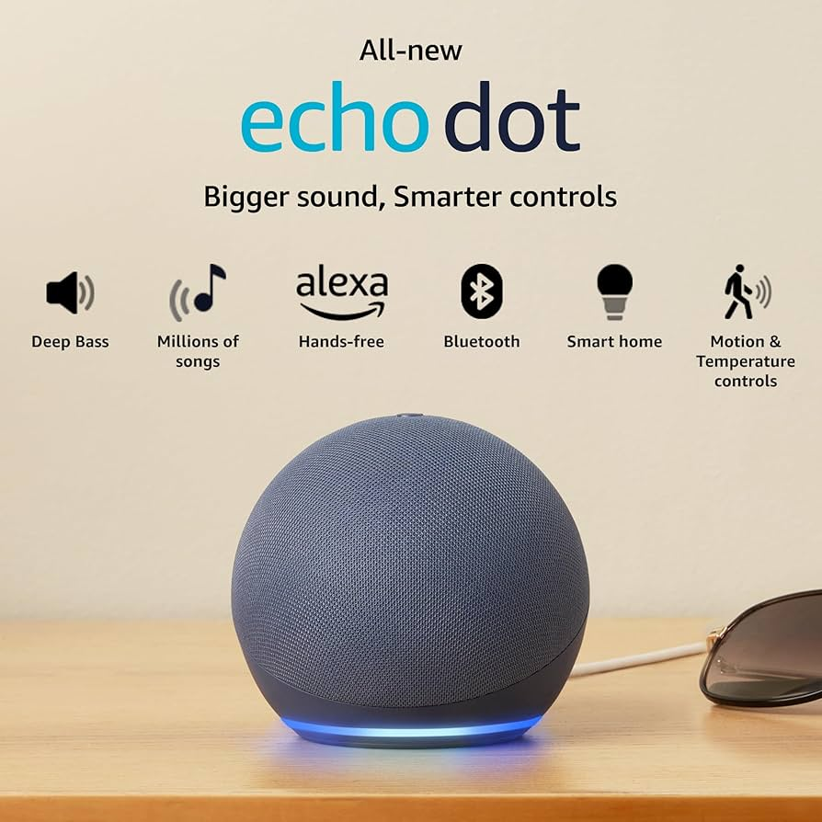
Interaction Design Consultants
Amazon Echo Dot with Alexa with simple in physical design—minimal buttons (volume, mute, action).
Uses voice commands to interact: "Alexa, play music", "What's the weather?“
Affords speaking through its glowing ring when active.

Slide 15
ACTIVITY
The iPod phenomenon
Apple's classic (and subsequent) generations of iPods (e.g. Touch, Nano, Shuffle) have been a phenomenal success. How do you think this happened?
How did this happen? Consider:
Simplicity in UI (click wheel navigation)
Seamless integration with iTunes
Emotional connection (branding, color variety, music personalization)
Sleek and portable design = Joy + Utility
User Experience was prioritized over just specs

Slide 16
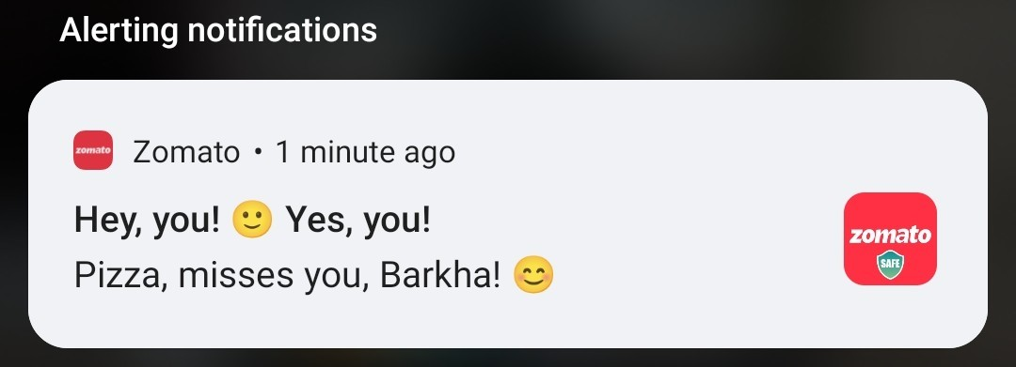
The User Experience (UX)
The User Experience (UX) is central to interaction design. It describes how a product behaves and is perceived when used by real people in real situations.
Designers often refer to UX as UXD (User Experience Design), emphasizing design thinking that prioritizes the quality of the user's overall experience over merely following design processes. (Allenwood and Beare, 2014)
As Norman (2004) notes:
“It is not enough that we build products that function, that are understandable and usable. We also need to build joy and excitement, pleasure and fun, and yes, beauty into people's lives.”
Example:
Zomato adds humor and delight in micro-interactions like loading messages.
Spotify not only works well but also makes music discovery joyful through curated playlists and mood-based mixes.

Slide 17
The User Experience (UX)
McCarthy and Wright (2004) propose four core threads that make up a user’s holistic experience with technology:
Sensual – sensory engagement (sight, sound, touch) Example: Haptic feedback in iPhones, vibrant UI colors in Instagram.
Emotional – feelings triggered by interaction Example: Happiness on receiving a "streak" notification on Snapchat, or frustration with failed online payments.
Compositional – how users make sense of experiences as they unfold Example: While shopping on Amazon, a smooth product > cart > payment flow feels logical and rewarding.
Spatio-temporal – the context of space and time in which the interaction happens Example: Using Google Maps while walking vs while driving; UX needs vary based on time pressure and location.
These threads act as lenses that help designers understand the relationship between technology and human experience. Rather than focusing on isolated metrics like usability or utility, this framework encourages designers to consider how all aspects of experience come together to create meaningful, joyful, and impactful interactions.

Slide 18
The User Experience (UX)
Sensual Thread: This is concerned with our sensory engagement with a situation and is like the visceral level of Norman’s model. It relates to the level of absorption people have with various technological devices and applications, such as:
Computer games,
Smartphones, and
Chat rooms,
where users can become highly immersed at a sensory level. These experiences can involve thrill, fear, pain, or comfort.
Modern Examples:
Immersion in VR games like Beat Saber or Meta Quest experiences.
Haptic feedback in smartphones (e.g., subtle vibration while typing on iOS).
ASMR video apps that engage hearing and sight for comfort.

Slide 19
The User Experience (UX)
The Emotional Thread:
Emotions like sorrow, anger, joy, excitement, frustration, and happiness arise from using technology.
Emotions are intertwined with context — e.g., a person becomes frustrated when a payment gateway fails repeatedly.
Emotional judgments affect product preferences:
A person may emotionally desire the latest iPhone because of its aesthetics, even if it's too expensive for them.
Cool-looking but high-cost phones create internal conflict—they can't afford it, but emotionally they want it.
Modern Examples:
Rage from losing unsaved work due to app crashes (e.g., in MS Word or design tools)
Joy when Duolingo gives celebratory animations for daily streaks
Emotional pull of product unboxing experiences, as seen with Apple products

Slide 20
The User Experience (UX)
The Compositional Thread: This thread is about the narrative or unfolding of an experience—how people make sense of it over time. This thread highlights the internal dialogue people have while using a product or service. In such scenarios, users ask:
What is this about?
Where am I? What has happened? What’s next?
What would happen if I click this…?
Modern Example:
Example: In online shopping, the sequence of pages or steps (product → cart → address → payment) can either create satisfaction or frustration.
When using Swiggy or Amazon, a user checks:
What item is this?
Is the price fair?
How many steps left until delivery? A broken or confusing sequence leads to drop-offs or cart abandonment.

Slide 21
The User Experience (UX)
The Spatio-Temporal Thread
This refers to the space and time context in which experiences occur and how they affect user behavior.
Different settings influence how we perceive time and space:
Time may feel fast, slow, or frozen based on engagement.
Space may feel private or public, safe or exposed.
Modern Examples:
Using Google Meet in a noisy café vs a quiet office
Netflix binge-watching feels like time passes quickly due to engaging UX
Work-from-home apps like Notion or Slack provide flexibility in space and time use

Slide 22
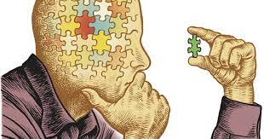
Interaction Design and the User Experience
What is usability ???

Slide 23
Interaction Design and the User Experience
Usability refers to how effectively, efficiently, and satisfactorily a user can interact with a product or system. It focuses on making interactive products:
Easy to learn
Efficient to use
Safe
Enjoyable
Supportive in achieving the user's goals across contexts like work, school, and everyday life.

Slide 24
Interaction Design and the User Experience
🔶 Six Key Usability Goals:
Effectiveness – How accurately and completely users achieve their goals. 🟢 Example: A banking app successfully completes a money transfer without errors.
Efficiency – How quickly users can perform tasks once they’ve learned the system. 🟢 Example: Google Search delivers relevant results within seconds.
Safety – Preventing errors and protecting users from dangerous outcomes. 🟢 Example: Gmail’s "Undo Send" option prevents accidental email sends.
Utility – The right functionality to do what users need. 🟢 Example: A calendar app allowing event creation, recurring entries, and reminders.
Learnability – How easy it is for new users to get started. 🟢 Example: Canva allows new users to create designs quickly using drag-and-drop templates.
Memorability – How easily users can return to a system after a break without needing to relearn. 🟢 Example: Users who return to Amazon after months can still easily find the cart, search bar, and wish list.

Slide 25
Interaction Design and the User Experience
🔷 Why Operationalize Usability Goals?
Usability goals are converted into practical questions (e.g., “Can a first-time user complete the task in under 3 minutes?”).
These questions help designers identify:
Hidden design flaws
Potential usability issues
Conflicting expectations from users
✅ Benefit: This approach enables early detection of design problems, saving time and improving the overall user experience before deployment.

Slide 26
Interaction Design and the User Experience
Effectiveness refers to how well a product enables users to achieve their goals. It is a general usability goal that focuses on the system doing what it's supposed to do—accurately and completely.
❓ Key Design Question:
Is the product capable of allowing people to learn, carry out their work efficiently, access the information they need, or buy the goods they want?
📌 Example – Online Shopping (Effectiveness in Action): When a user makes a purchase online, they typically fill out forms with personal information.
Effectiveness is demonstrated when:
The site saves that information securely.
On future visits, users do not have to re-enter their details.
A classic implementation of this is Amazon’s "1-Click" purchase system, where:
Returning users can purchase an item with just one click.
This enhances speed, convenience, and overall task success.

Slide 27
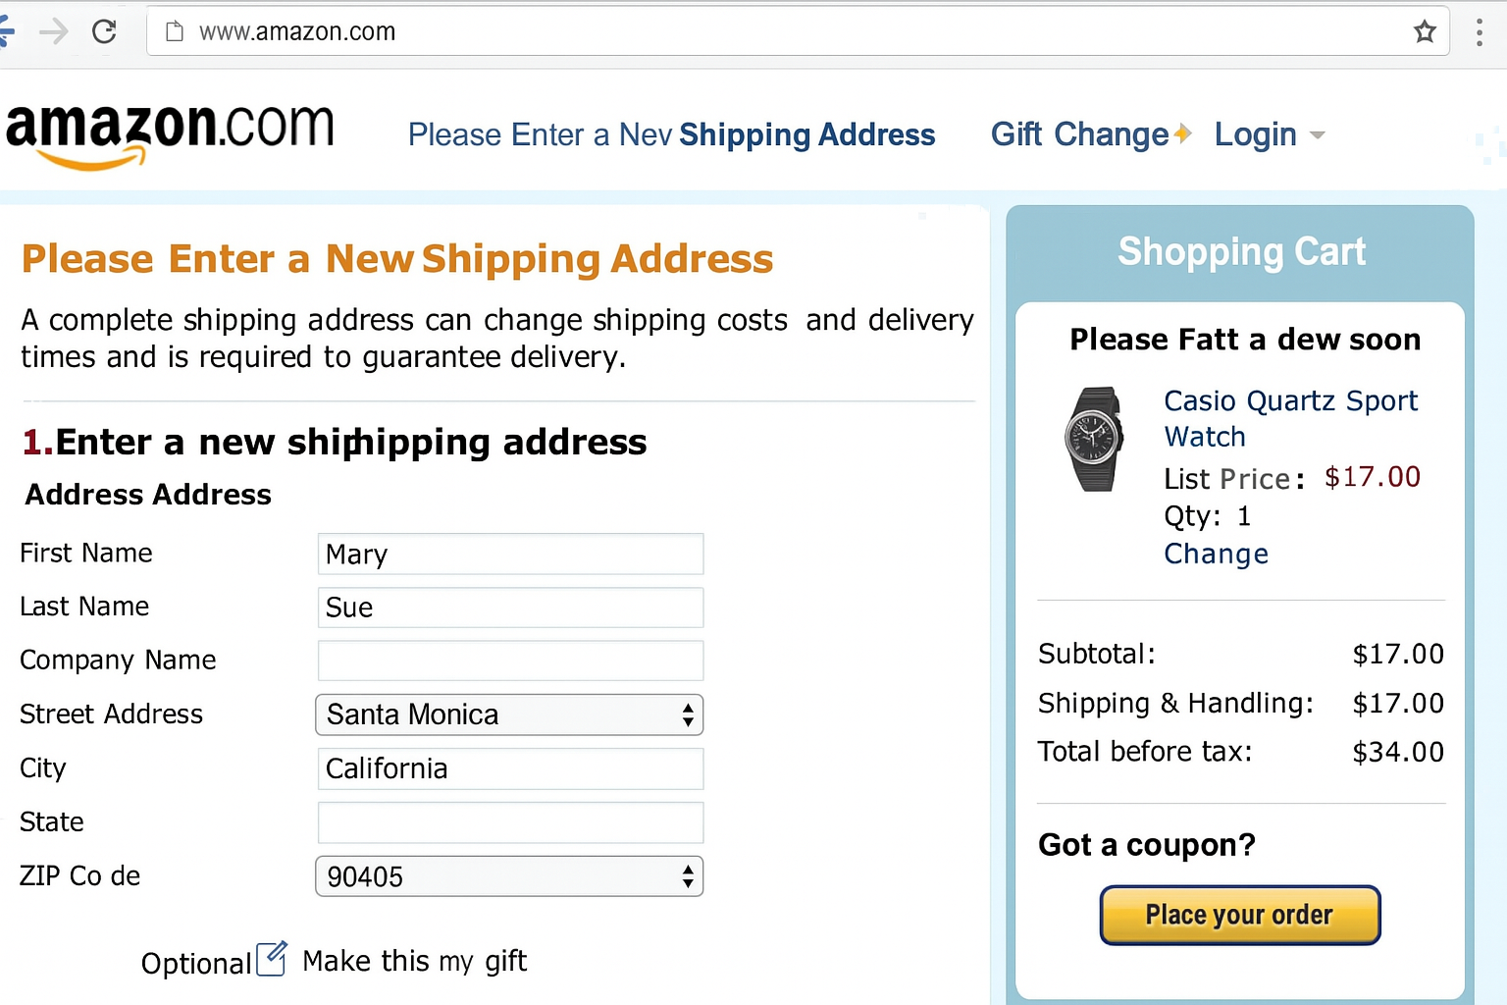
Interaction Design and the User Experience

Slide 28


Interaction Design and the User Experience
Safety involves protecting users from dangerous conditions and undesirable situations. It also relates to ergonomics—ensuring the environment and tools do not cause harm. Safety in interaction design ensures that systems are designed to prevent user errors and allow safe operation even in high-risk conditions..
❓ Question: Once users have learned how to use a product to carry out their tasks, can they sustain a high level of productivity without facing harm or danger?
Examples:
Medical Imaging Systems: Operators of MRI or CT scan machines use remote software interfaces to avoid direct exposure to radiation. These systems include fail-safes, auto shut-off features, and warning prompts to prevent misuse.
Industrial Automation: In hazardous industries (e.g., chemical plants), robots and control systems are operated via remote dashboards, reducing human exposure to toxic environments.
Self-Driving Cars: These vehicles have built-in collision avoidance systems and alerts to reduce driver error, ensuring safety in complex road conditions.

Slide 29
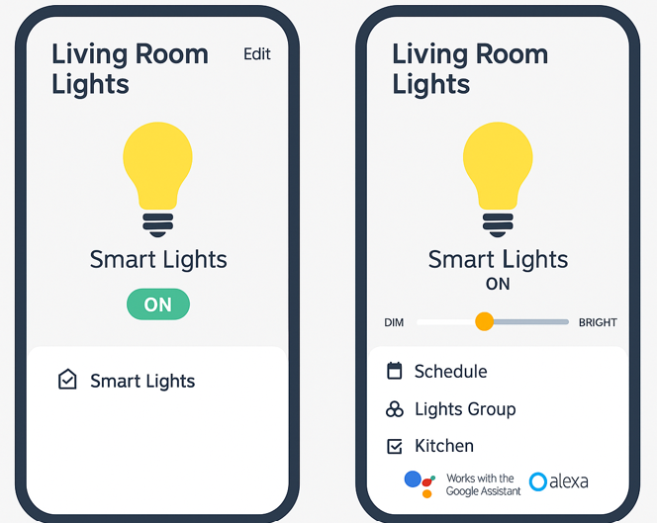
Interaction Design and the User Experience
Utility refers to the extent to which the product provides the right kind of functionality so that users can do what they need or want to do.
❓ Question:
What is the range of errors that are possible using the product and what measures are there to permit users to recover easily from them?
💡 Examples:
✅ High Utility: A modern accounting software like QuickBooks or Zoho Books allows tax calculations, GST management, and report generation with automation and data import features—making it highly useful to accountants and business owners.
❌ Low Utility: A basic drawing tool that only supports fixed shapes (e.g., circles and rectangles) and lacks undo/redo, layering, or freehand options. It may frustrate designers trying to create complex or expressive art.
A smart home app with low utility might only allow ON/OFF control of lights. A higher utility app allows dimming, scheduling, grouping lights, and even integration with voice assistants like Alexa or Google Assistant.

Slide 30
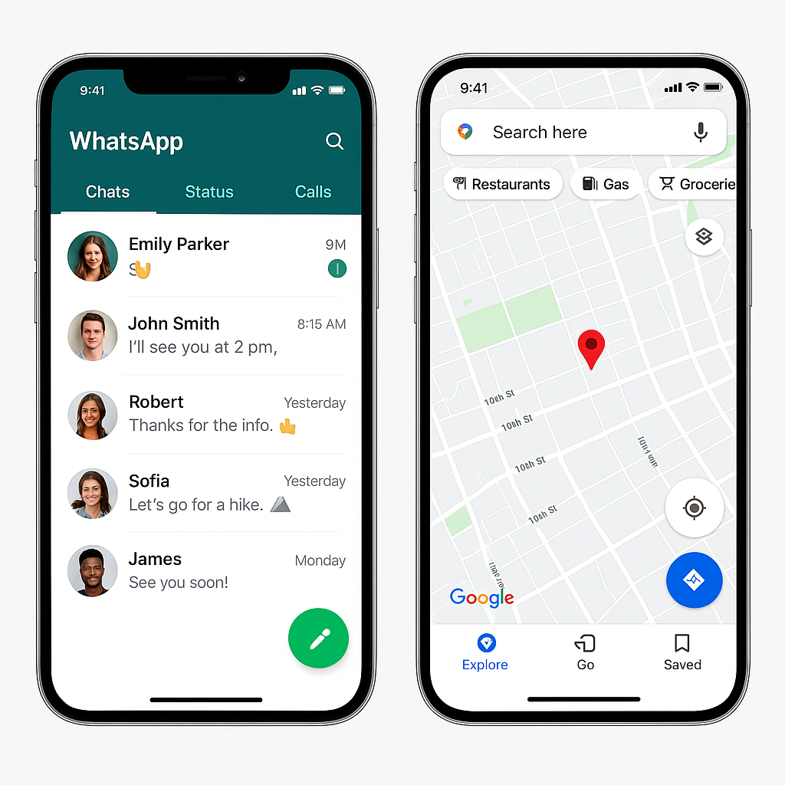
Interaction Design and the User Experience
Learnability refers to how easy a system is to learn to use. It is well known that people don't like spending a long time learning how to use a system. They want to get started straight away and become competent at carrying out tasks without too much effort.
❓ Question:
Does the product provide an appropriate set of functions that will enable users to carry out all their tasks in the way they want to do them?
Example:
High Learnability: Apps like WhatsApp or Google Maps are designed with clear icons and guided prompts, enabling new users to send a message or find a location without tutorials.
Occasional-use systems: For systems like income tax portals or insurance claim forms, simplicity and clear navigation are key to ensuring users can complete tasks without confusion or errors.
Modern Example: A home service booking app that uses self-explanatory icons, and a guided booking process helps users' complete bookings with ease, even if they use it only occasionally.

Slide 31
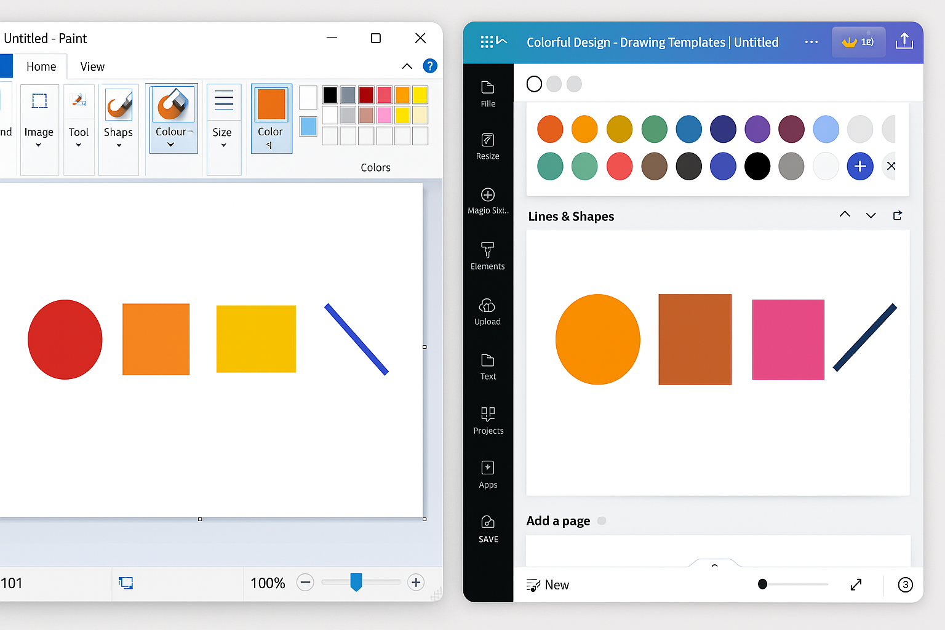
Interaction Design and the User Experience
Memorability refers to how easy a product or interface is to remember how to use, once it has been learned. A memorable system enables users to return to it after a period of not using it and quickly reestablish proficiency.
❓ Question:
Is it possible for the user to work out how to use the product by exploring the interface and trying out certain actions? How hard will it be to learn the whole set of functions in this way?
Example: Placing frequently used tools and actions consistently in the same location across sessions helps users remember where to look.
In Google Docs, the toolbar is always fixed at the top—making it easy for returning users to locate formatting tools like bold, align, and highlight.
MS Paint and Canva keep color palettes and shape tools in the same layout—so users quickly recall and resume tasks.
Netflix and YouTube use persistent layouts (e.g., “Watch Later,” “Recently Watched”) to reduce user effort in resuming past actions.

Slide 32
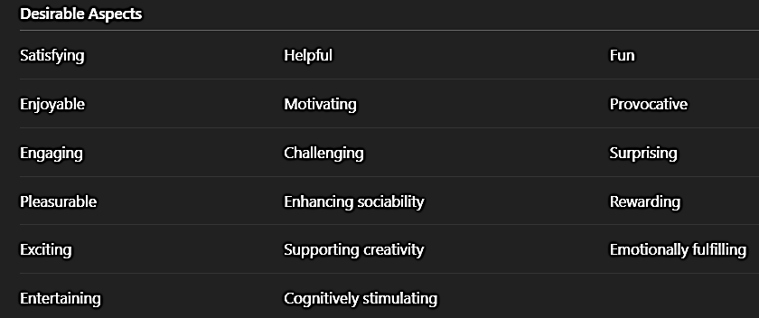
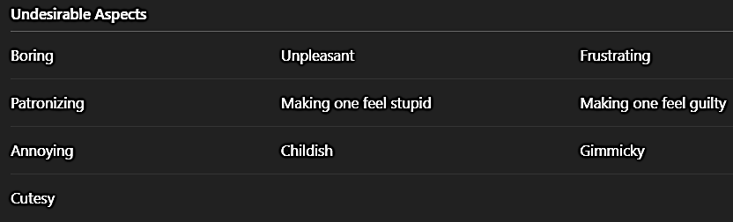
User Experience Goals
Diversity of user experience goals has been articulated in interaction design, which includes a wide spectrum of emotions, perceptions, and felt experiences. These are categorized into desirable and undesirable aspects.
These are subjective qualities, focusing on how the user feels during the interaction.
They differ from usability goals (which are objective), as they focus on emotional satisfaction, enjoyment, and overall appeal.
The goal is to create positive emotional responses while minimizing negative ones.

Slide 33
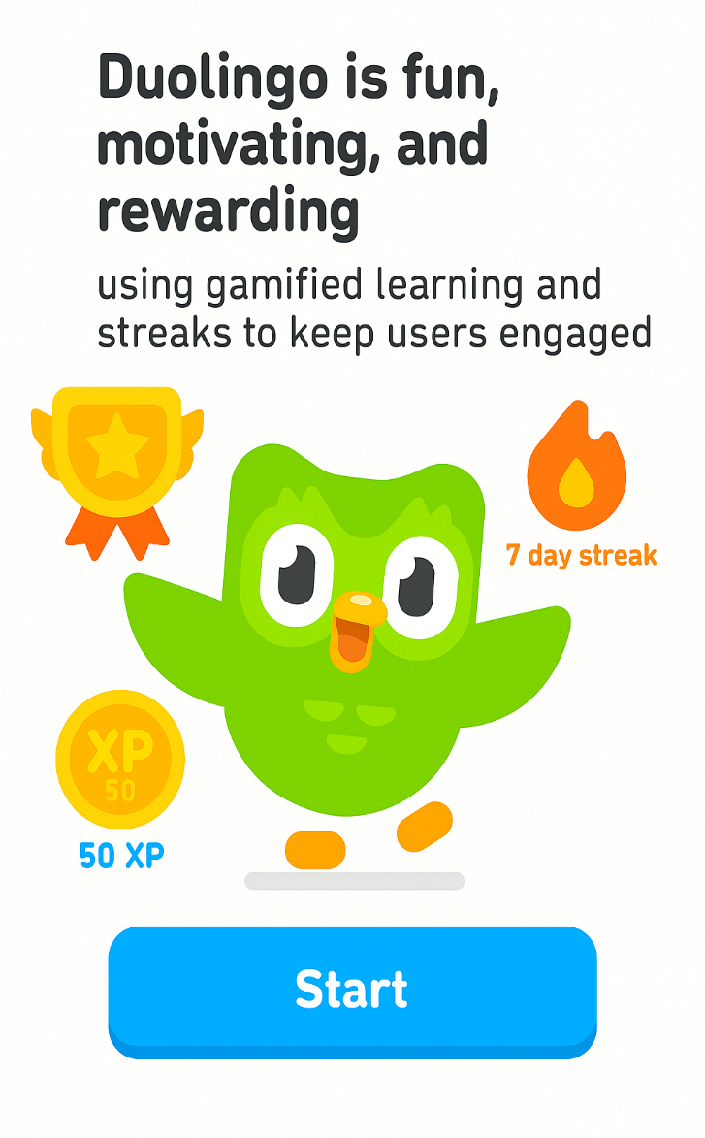

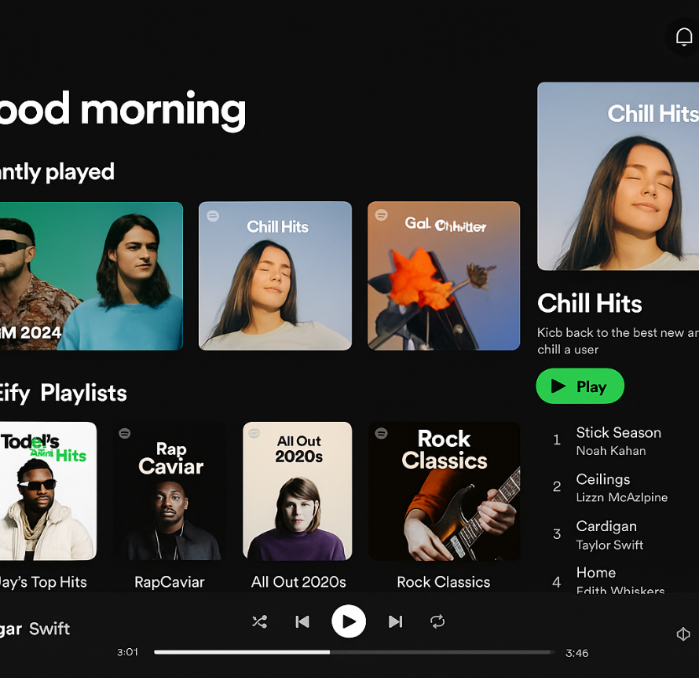
User Experience Goals
Spotify offers a satisfying and pleasurable experience through curated playlists and seamless navigation.
Poorly designed pop-up ads are often annoying, frustrating, and patronizing, negatively impacting the UX.

Slide 34
Design principles
Design principles serve as guiding rules that help interaction designers craft intuitive, user-centered interfaces. These principles are drawn from a combination of theory, real-world design experience, and practical common sense. They act as prescriptive recommendations—helping designers understand what to do and avoid to enhance usability and the overall user experience.
Common Design Principles:
Visibility: Ensure users can easily see what functions are available. The interface should not overwhelm or hide key actions.
Example: In Google Docs, formatting options are clearly visible in the toolbar, so users don’t need to search menus to apply bold or italic styles.
Feedback : The system should provide immediate and informative feedback in response to user actions.
Example: When you send a message on WhatsApp, ticks appear to indicate delivery and read status—keeping the user informed.
Constraints: Design should prevent user errors by limiting the actions that can be taken.
Example: In an online form, date fields may use a calendar picker so users can only select valid dates—reducing formatting errors.
Consistency: Interfaces should follow platform conventions and maintain uniform design across screens.
Example: Apple apps use consistent icons and gestures across iOS, making it easier for users to learn new apps on the platform.
Affordance: Elements should visually suggest how they are used.
Example: Buttons on a webpage often look raised or shaded, indicating they can be clicked.

Slide 35
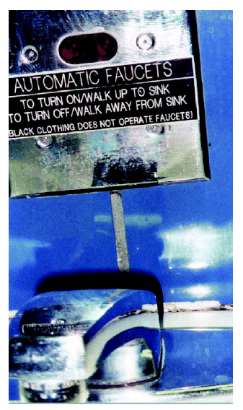
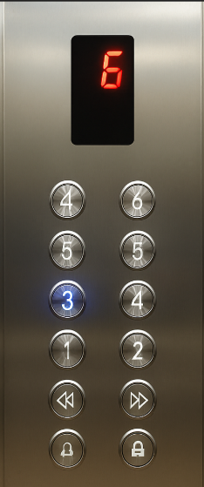
Design principles
Visibility in interaction design refers to making key functions and system status readily apparent to users. When users can clearly see what options are available, they are more confident and efficient in using a product.
Avoid hiding primary actions in menus or icons without labels. Use clear symbols or text (like 🗑️ for delete, 💾 for save) to reinforce functionality.
❌ Poor Visibility Example (as shown):
At the Cincinnati airport, an automatic faucet required users to walk up to turn it on and walk away to turn it off.
However, users wearing black clothing were unable to activate it due to poor sensor design.
A sign was added, but the original issue was caused by low visibility of how the system worked.
✅ Good Visibility Example:
Elevator Control Panels: Most modern elevators now include backlit buttons and digital floor indicators, making it clear which floor is selected or in progress.
Google Docs Toolbar: Formatting tools like bold, font size, and alignment are always visible in the toolbar, reducing user confusion.

Slide 36


Design principles
Feedback is crucial in interaction design as it informs users about what action has been taken, what result has occurred, and what to do next.
It helps bridge the gap between action and understanding, giving users confidence and control.
Feedback can be:
Visual – buttons changing color, progress bars
Audio – alert tones, voice responses
Tactile – vibration on smartphones when typing
Verbal/Textual – system messages or pop-up alerts
Multimodal – combination of two or more types above

Slide 37

Design principles
💡 Examples:
✅ WhatsApp: When a message is sent, double ticks appear; they turn blue once read – a clear form of visual feedback.
✅ Elevators: Illuminated floor numbers or a “ding” sound signal selection and arrival.
✅ Online forms: Fields turn red for missing/incorrect input with instant error messages.
✅ Mobile Apps: After clicking a button, slight animations or loading spinners provide instant confirmation.
✅ Fitness Wearables (like Fitbit/Apple Watch): Haptic feedback when step goal is achieved or heart rate zones change.

Slide 38
Design principles
Constraints
The design principle of constraints refers to limiting the possible actions a user can take at a given time to prevent errors and guide behavior.
Types of constraints can include:
Physical (e.g., shape of a plug that fits only one socket),
Logical (e.g., grayed-out buttons when action isn't valid),
Cultural (e.g., red means stop),
Semantic (e.g., icons that imply meaning).
✅ Key Benefits:
Reduces the chance of invalid actions.
Helps users focus only on relevant options.
Improves efficiency and safety in complex systems.

Slide 39
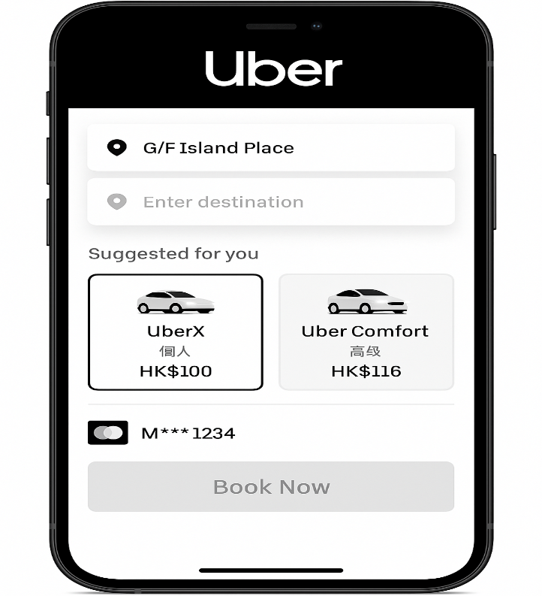
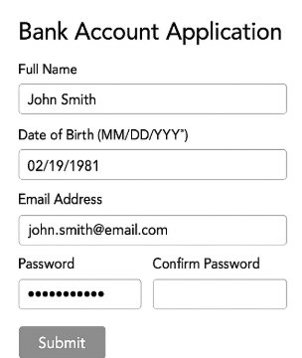
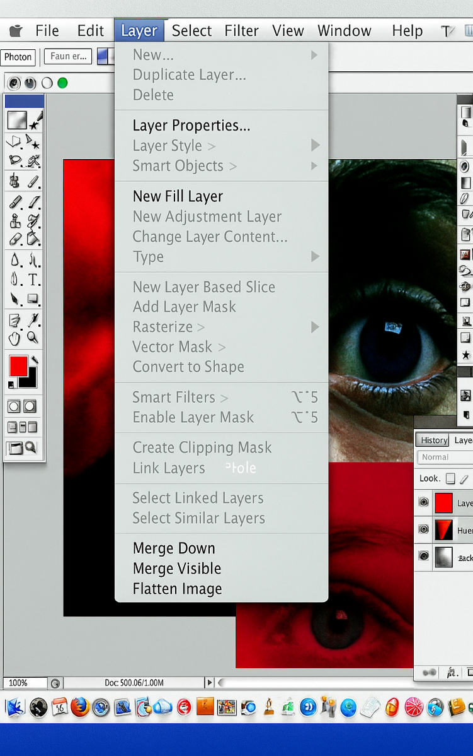
Design principles
In photo editing software like Photoshop, certain menu options are grayed out until the user selects an appropriate layer or image region, effectively guiding them to take the next logical step.
Mobile Apps: When booking a cab via Uber, the “Book Now” button remains inactive until you’ve selected a location and payment method.
Online Forms: In banking or travel portals, the “Submit” button is often disabled until all mandatory fields are filled correctly, reducing user errors

Slide 40
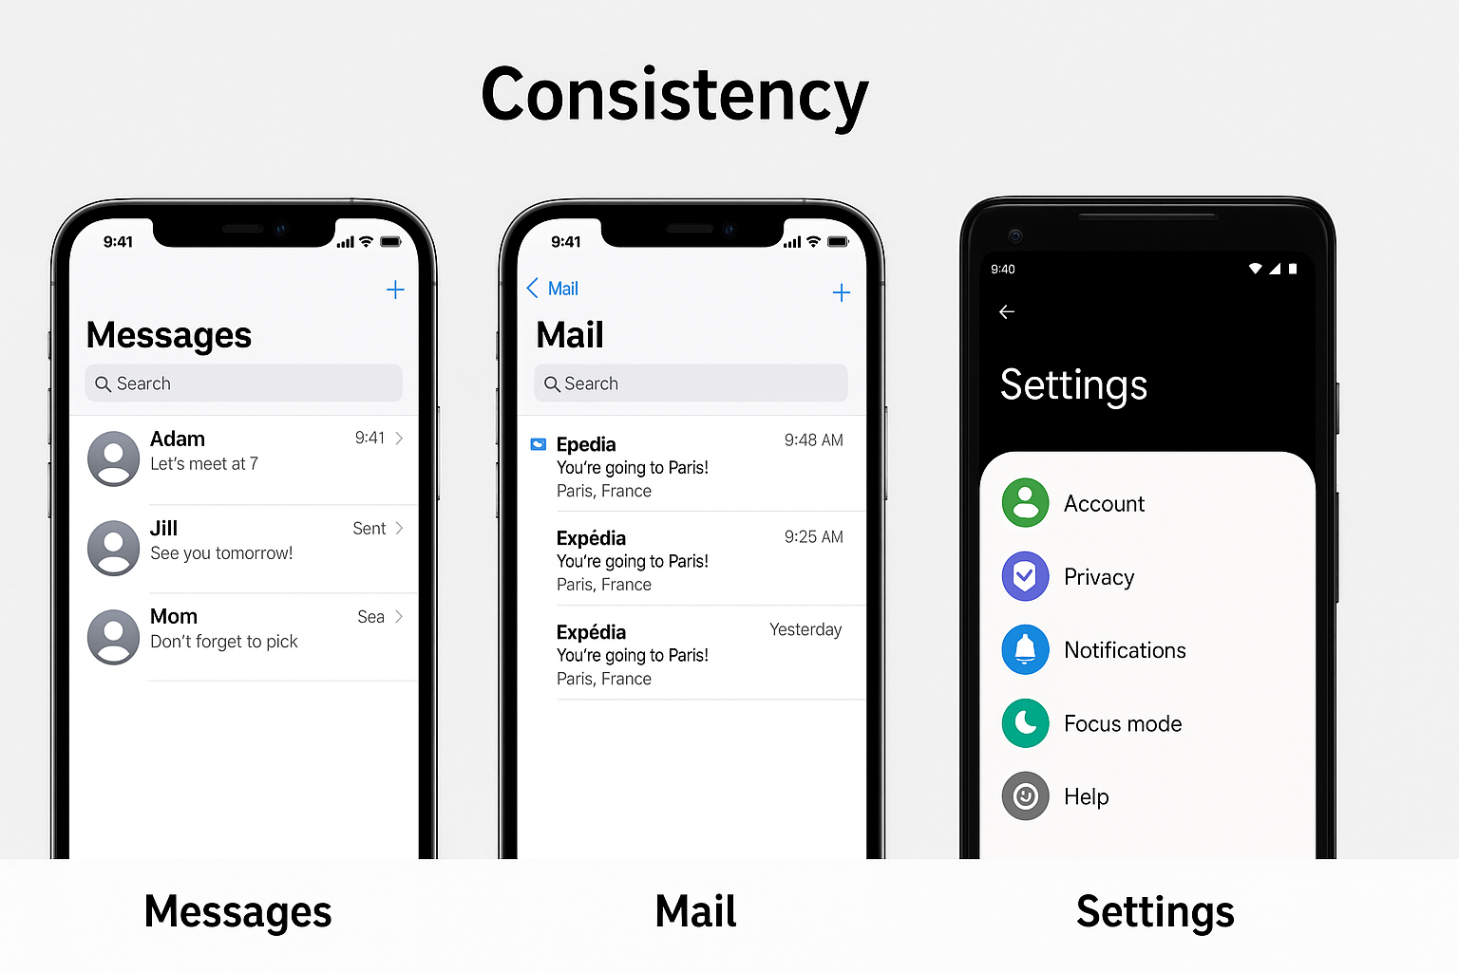
Design principles
Consistency.
Consistency refers to designing interfaces to use the same operations and similar elements across tasks to reduce the learning curve and cognitive load.
A consistent interface follows predictable rules (e.g., Ctrl+C always means copy across apps).
It improves usability by allowing users to transfer knowledge from one part of the interface to another or even across applications.
Examples:
Google Ecosystem (Docs, Sheets, Gmail): Same layout for menus, shortcuts (Ctrl+Z, Ctrl+P), and sidebars. Users easily switch between them without relearning.
Mobile Apps (iOS & Android Guidelines): Navigation bars, back arrows, and settings icons behave similarly across apps due to platform design standards.

Slide 41
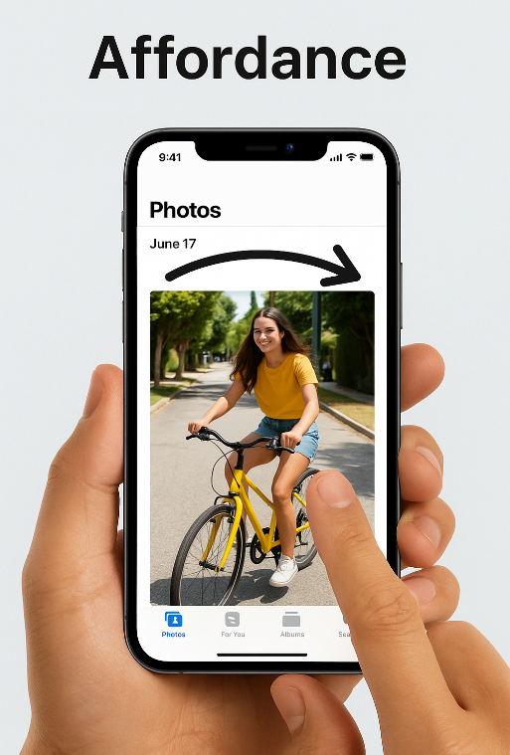
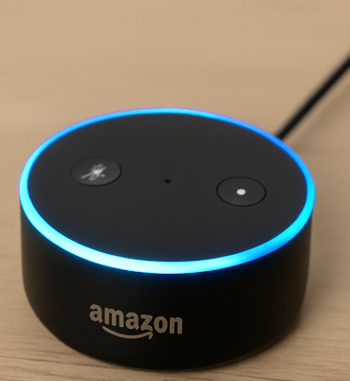
Design principles
Affordance refers to an attribute of an object that suggests how it should be used. It helps users intuitively understand possible interactions.
Don Norman (1999) categorized affordances into:
Real Affordance: Physically perceptible, like a button you can push.
Perceived Affordance: What the interface suggests to the user visually or by design cues.
Key Concepts:
Physical Affordance: Obvious actions from physical cues. Example: A mug handle “affords” holding; a push plate on a door “affords” pushing.
Virtual Affordance: Interface elements that imply interaction. Example: Underlined text in websites implies clicking.
Examples:
Mobile Apps: Swipe gestures on photos or emails afford navigation or deletion.
Touchscreens: Icons shaped like buttons indicate tapping (e.g., app icons or play buttons).
Voice Assistants: A glowing ring on Amazon Alexa implies it's listening (affords speaking).
Smart TVs: Remote buttons with volume or arrow symbols afford navigation and adjustment.

Slide 42
Cognition
Cognition refers to the mental processes involved in thinking, learning, remembering, perceiving, deciding, and communicating.
It includes both experiential (fast, intuitive) and reflective (slow, deliberate) modes of thinking. These processes are context-dependent and can be distributed, situated, extended, or embodied depending on the tools, environment, and people involved.
Experiential Cognition (Fast Thinking):
This is intuitive, automatic, and effortless thinking. It occurs during activities that we're familiar with, requiring little conscious thought.
Examples: Driving a familiar route, reading, playing a game, casual conversation.
Reflective Cognition (Slow Thinking):
This involves deliberate, conscious mental effort. It is analytical and helps with problem-solving, planning, and decision-making.
Examples: Designing a product, writing an essay, solving a math problem.

Slide 43
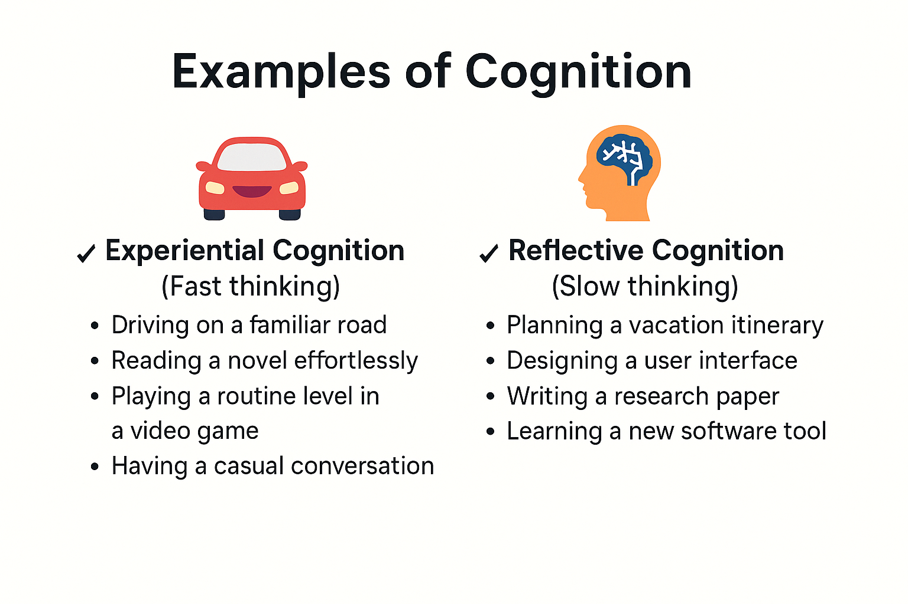
Cognition

Slide 44
Cognition
Cognition has also been described in terms of specific kinds of processes. These include:
Attention
Perception
Memory
Learning
Reading, speaking, and listening
Problem solving, Planning, Reasoning, and Decision making.

Slide 45
Cognition - Attention
Attention:
Attention is the process of focusing on specific information while ignoring others, using our senses like hearing (auditory) and sight (visual). It's crucial when many things compete for our focus.
Types of Attention with Examples
🟢 Auditory Attention
🟢 Visual Attention

Slide 46
Cognition - Attention
Auditory Attention is the ability to focus on specific sounds in our environment while filtering out others.
Real-World Example: Imagine you're sitting in a dentist's waiting room. There may be background music, people talking, or phones ringing. But your attention is tuned specifically to listen for your name to be called by the receptionist or nurse.
🧠 Your brain filters out irrelevant sounds and stays alert to a specific cue.
🎯 This is goal-directed attention – you're listening for something important to you.
Other relatable examples:
Hearing your name announced at an airport gate.
Listening for a timer to ring while cooking.
Waiting for a notification sound during an exam result release.

Slide 47
Cognition - Attention
👁️ Visual Attention is the process of focusing your sight on specific visual information while ignoring the rest.
Real-World Example: You're scrolling through a live football score feed on your smartphone. The screen is filled with multiple match updates, ads, and images—but your eyes quickly scan for your favorite team’s score.
🔎 You may ignore unrelated matches or information.
💡 This shows goal-driven filtering based on what’s meaningful to you.
Other relatable examples:
Finding your name on a college results list.
Scanning a supermarket shelf for your preferred snack.
Looking for a specific app icon on a cluttered home screen.

Slide 48
Cognition - Attention
Key Factors That Guide Attention in Design:
Attention is shaped not only by user goals but significantly by how information is visually presented. A well-designed interface guides users effortlessly, while a poorly designed one leads to confusion and cognitive overload.
Key Visual Design Factors:
🖼️ Visual Clarity 🎨 Color Usage 📍 Positioning 🧩 Grouping and Layout

Slide 49
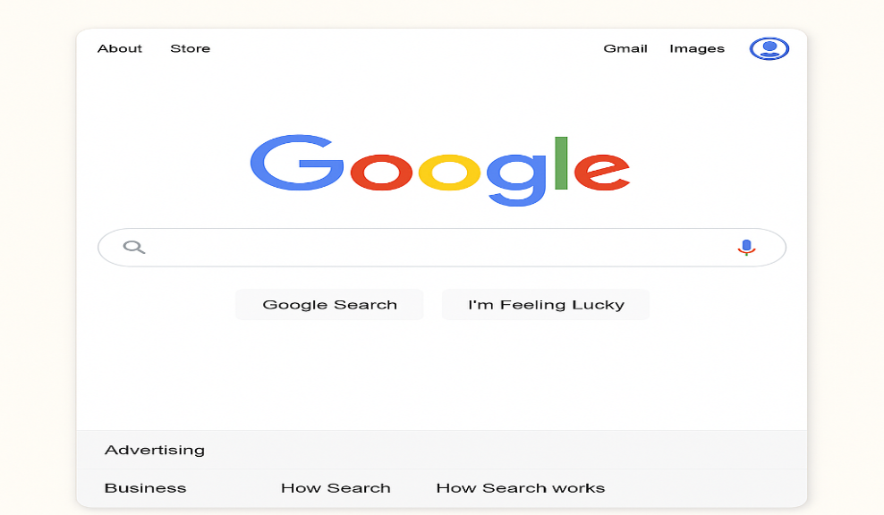
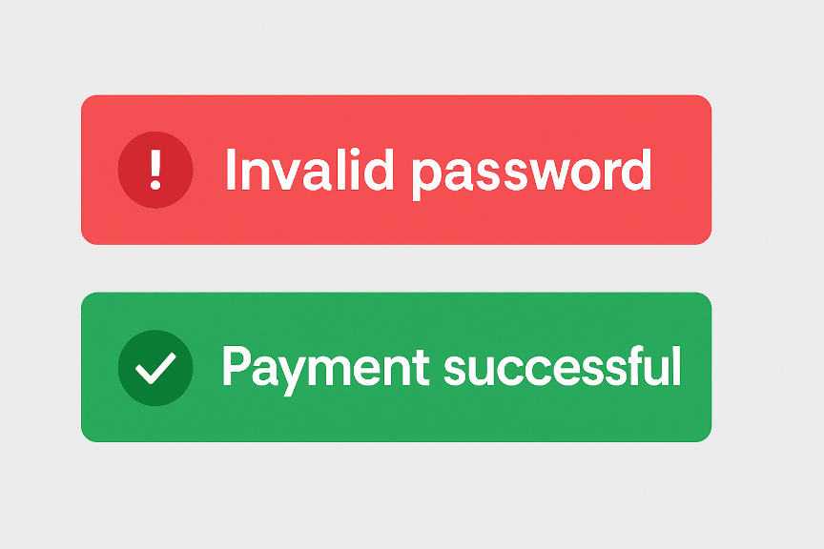
Cognition - Attention
Visual Clarity
Text must be readable (good font size, spacing).
Interface should avoid clutter.
Example: A clean homepage with organized sections (like Google Search) helps users focus on the task.
Color Usage
Bright or contrasting colors draw the eye.
Use colors to highlight important elements (e.g., buttons, warnings).
Example: Red is used for error messages; green for success confirmation.

Slide 50
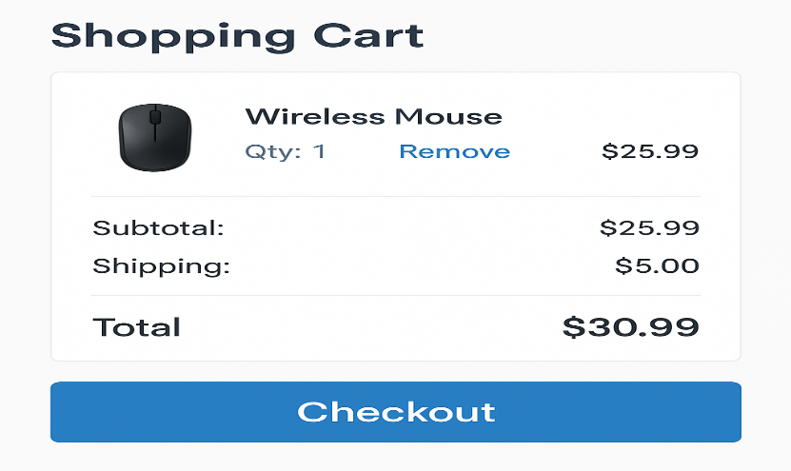
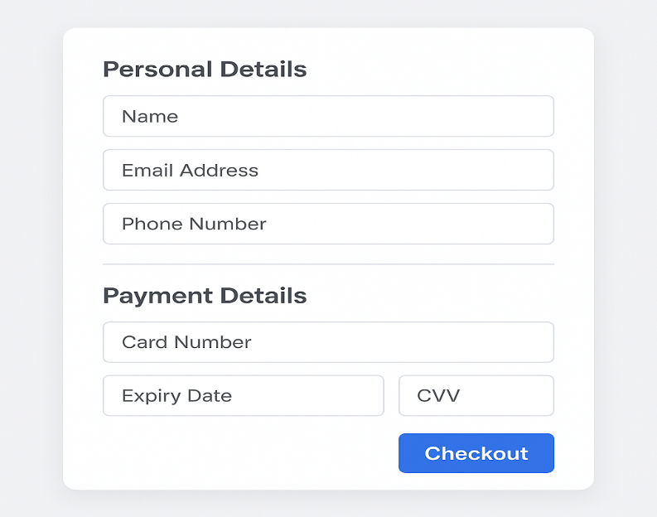
Cognition - Attention
Positioning
Users typically scan screens in an F-pattern or Z-pattern.
Place important actions (like "Add to Cart", "Next", "Submit") where users naturally look.
Example: Checkout buttons are usually at the bottom right because that’s where users expect them.
Grouping and Layout
Group related items together for better understanding (Gestalt principle).
Example: In online forms, personal details and payment details are shown in separate sections to reduce confusion.

Slide 51
Cognition - Attention
Factors Affecting Attention
Attention is not just automatic—it depends on what we’re trying to achieve and how information is shown to us. Two major factors influence how we focus:
✅ 1. Our Goals
When we have a clear goal, our attention becomes focused and selective.
Example: If your goal is to check World Cup results, you'll quickly scan headlines, apps, or ask someone directly—ignoring unrelated content.
When we have a vague goal, our attention becomes more exploratory.
Example: At a restaurant with no fixed dish in mind, you browse the menu. Your attention is drawn to:
Descriptive dish names (“Sizzling Paneer” 🍽️)
Photos, price, or chef’s recommendations
Mood or what others are ordering

Slide 52
Cognition - Attention
Factors Affecting Attention
✅ 2. Information Presentation: How information is organized, displayed, and styled greatly affects our ability to focus.
🟢 Well-presented information makes attention effortless:
Headings, icons, white space, and categories help guide your eyes.
Example: Shopping apps like Amazon show filters, categories, and product highlights clearly.
🔴 Cluttered design makes it hard to locate key items:
Too much text, mixed fonts, or poor grouping = confusion
Example: Government websites or exam portals often frustrate users due to poor layout.

Slide 53
Cognition - Perception
Perception is how users acquire and interpret information through their senses (vision, hearing, touch) to form an experience.
👀 Why It Matters in UX/UI Design:
Vision is the most dominant sense, especially for sighted users.
Interfaces should display information in a way that users can easily and correctly perceive.
Key Concepts:
Grouping & Spacing:
Items grouped closely are perceived as related.
White space (blank space) helps in scanning and locating information easily.
Too much white space?
Can slow users down if overused—balance is key.

Slide 54
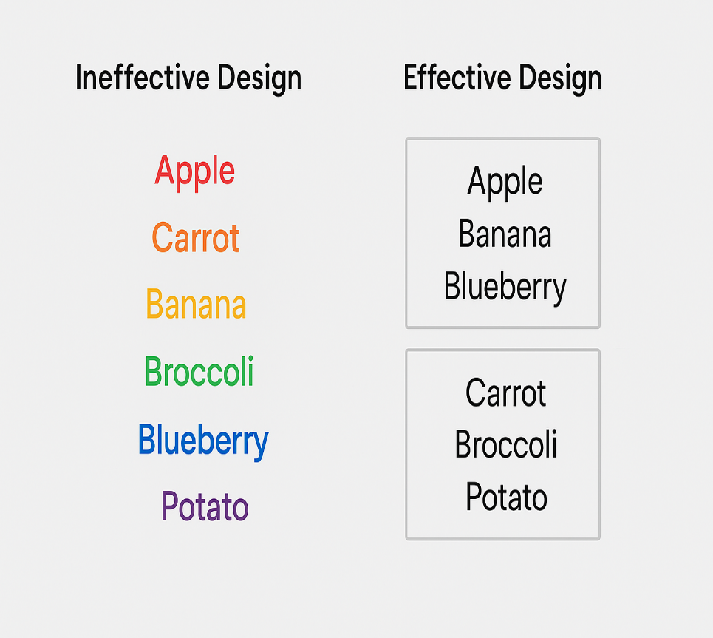
Cognition - Perception
🧪 Research Insight:
Spool et al. (1997): Excessive white space can hinder quick access to information.
Weller (2004):
Borders are better than color contrast for grouping.
Users locate items faster in bordered layouts.
🖼️ Visual Design Tip:
Prefer borders for grouping related content (e.g., menus, form sections).
Avoid over-reliance on color contrast alone for grouping.
📝 Practical Example:
Ineffective Design: List of items using only different colors .
Effective Design: Clear boxes or borders around groups.

Slide 55
Cognition - Perception
Design Implications – Perception
📌 Goal: Ensure users perceive and recognize information correctly across various media.
🔍 Key Guidelines:
🖼️ Icons & Graphics: Must be visually distinct and intuitively meaningful.
📦 Borders & Spacing: Use to group related content for easier scanning and locating.
🔊 Sound: Should be audible and clearly distinct to convey correct feedback (e.g., error beep vs. success chime).
🗣️ Speech Output: Ensure clear pronunciation and understandable content (e.g., voice assistants or ATMs).
🔤 Text & Background: Use high contrast for readability:
✅ Yellow on black/blue → Good
❌ Yellow on white/green → Bad
✋ Tactile Feedback: In VR/AR or wearables, touch sensations must be distinct and meaningful (e.g., squeeze ≠ tap).

Slide 56
Cognition- Memory
Definition: Memory is the ability to store, retain, and recall information and experiences that allow us to act appropriately in different situations.
Key Features:
Versatile and essential for day-to-day functioning.
Works through filtering and encoding.
Involves different types: short-term, long-term, recognition, and recall.
Example:
Recognizing a friend’s face at a party and remembering where you last met them and what you spoke about.

Slide 57
Cognition- Memory
The Filtering Process of Memory
How it works:
We are exposed to enormous sensory data.
Filtering decides what is processed and stored.
Important for avoiding cognitive overload.
Encoding:
Determines what we pay attention to and how we interpret it.
Deeper processing = better memory.
Example:
You may forget a random phone number quickly but remember a concept better if you discussed and reflected on it.

Slide 58
Cognition- Memory
Context and Recognition vs. Recall
Context Matters:
We often encode memories within a specific context.
Retrieving info out of that context becomes difficult.
Recognition is Easier: People recognize information (e.g., images, faces) better than recalling it from scratch.
Example:
You're trying to recall your ATM PIN while shopping online at home, but you can’t remember it. However, when you stand at the ATM machine, your fingers automatically type it in without thinking.

Slide 59
Cognition- Memory
Memory & Digital Systems
Challenge: Organizing thousands of digital files, photos, videos, and emails.
Two memory processes:
Recall-Directed: Remembering specific file names or folders.
Recognition-Based: Scanning a history or thumbnails.
Design Implication: Interfaces must support tagging, time stamping, categories, and search functions.
Example:
You're trying to find a PDF of your semester notes saved months ago. You don’t remember the exact file name.
You open your Downloads folder, sort by date, or glance at file thumbnails with visible headings and icons — and instantly recognize the file you need.

Slide 60
Cognition- Memory
The Magical Number 7 ± 2
Theory by Miller (1956):
Short-term memory can hold 5 to 9 chunks of information.
A chunk could be a number, word, or concept.
Misapplication: Designers mistakenly use this to limit menu items, bullets, or tabs on screens.
Correct Understanding: Visual items can be scanned repeatedly – not subject to memory limits.
Example: Scanning 20 icons on a toolbar is easier than trying to remember them from hearing.

Slide 61
Cognition- Memory
Memory Load in Real Life – Phone Banking
Scenario: Banks ask for random letters of a password to ensure security.
Cognitive Load: Users must mentally count and recall, causing stress.
Coping Strategy: People often write it down, defeating the purpose of security.
Design Suggestion: Use secure pattern-based or biometric login methods that reduce memory burden.

Slide 62
Cognition- Memory
Design Implications for Memory
Don’t overload users with complex sequences.
Promote recognition over recall (e.g., menus with icons).
Provide multiple ways to encode (tags, timestamps, categories).
Use consistent UI layouts to help form habits.
Avoid asking users to remember obscure or random information.
Quote to End: "Design should reduce memory effort, not increase it." – UX Principle

Slide 63
Cognition - Learning
Learning is the process through which users gain knowledge or skills through experience, study, or interaction.
Key Insight: People learn better by doing rather than by reading static manuals.
Why it matters in UI/UX: Interfaces that allow exploration, experimentation, and undo actions support active learning.
Example: A new photo editing app that allows trial-and-error with “Undo” helps users learn better than a written tutorial.

Slide 64
Cognition - Learning
Benefits of Interactive Technologies in Learning
Technologies that aid learning:
Web-based learning platforms
eLearning systems
Multimedia tools
Virtual Reality (VR)
Advantage: They offer multiple representations of a concept – graph, formula, animation, sound – making abstract concepts easier to understand.
Example: A language learning app like Duolingo teaches vocabulary using multiple representations:
A word in text,
An accompanying image,
Audio pronunciation,
And a sentence usage example.

Slide 65
Cognition - Learning
Dynalinking – Bridging Abstract & Concrete
A method that links abstract concepts (like diagrams) to concrete simulations dynamically.
Changes in one are reflected in the other in real-time.
Educational Impact: Helps students better understand relationships between theory and application.
Example: In Pondworld, children see a simulation of organisms eating each other while the food web diagram updates live, and audio cues like “chomp!” reinforce attention.

Slide 66
Cognition - Learning
Domains Where Dynalinking Works Well
Effective in teaching:
Ecological systems
Economic forecasting
Molecular biology
Statistics & data visualization
Why it helps: Makes multidimensional relationships more visible and easier to grasp.
Example: Linking an economic dashboard (graphs, maps) with simulation models of currency inflation to show how changing one variable affects the rest.

Slide 67
Cognition - Learning
Design Implications for Learning
To Support Learning Through Design:
✔️ Encourage exploratory learning (trial and error).
✔️ Allow safe mistakes with Undo options.
✔️ Guide users through structured onboarding and guided interactions.
✔️ Use dynalinking where possible to connect theory and practice.
✔️ Recognize the role of tools like search engines, and support just-in-time learning.
Quote to End: "Learning is best supported when users can explore freely, fail safely, and see how actions connect to outcomes." – UX Learning Principle

Slide 68
Cognition-Reading, speaking, and listening
Language Processing in Interaction Design
Modes of Language:
Reading (Visual)
Speaking (Verbal)
Listening (Auditory)
Key Insight: While meaning remains constant across all modes, ease of processing differs based on person and context.
Example: Sentence: “Computers are a wonderful invention” – has the same meaning whether read, heard, or spoken.

Slide 69
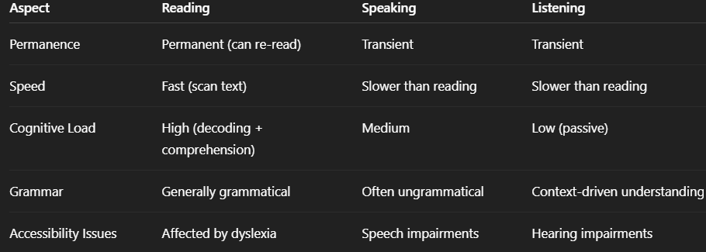
Cognition-Reading, speaking, and listening

Slide 70
Cognition-Reading, speaking, and listening
Applications Supporting These Modes
Technologies that support reading/speaking/listening:
📖 Interactive Books – help with language learning
🎙️ Speech Recognition – Google Voice Search, Siri, Alexa
🗣️ Text-to-Speech – for blind or dyslexic users
🤖 Natural Language Systems – Chatbots like Ask.com
🧠 Cognitive Aids – Writing support tools for disabilities
🔊 Auditory Navigation Tools – Blind users navigating graphs with sound.
Example: A student with dyslexia uses a text-to-speech app to listen to notes instead of reading.

Slide 71
Cognition-Reading, speaking, and listening
Design Implications for Interfaces: Design Recommendations:
✔️ Keep spoken instructions short – 3-4 options max
✔️ Improve clarity of artificial speech – use better intonation
✔️ Support large text resizing – without breaking layout
✔️ Provide alternatives – audio and text versions of content
✔️ Design for inclusivity – speech input, auditory feedback, tactile diagrams
Example: A smart home device should give short spoken options like:
“Turn lights on”
“Set alarm”
“Play music”

Slide 72
Cognition - Reflective Cognition
These processes involve conscious, deliberate thought to determine actions, evaluate consequences, and choose optimal paths.
Key Processes:
🧩 Problem Solving
📅 Planning
🧠 Reasoning
✅ Decision Making
Context of Use:
Choosing travel routes
Comparing smartphones
Selecting university courses
Planning weekend trips with friends

Slide 73
Cognition - Reflective Cognition
Real-World Example – Planning a Route
Use Case: Navigating a foreign city
Ask friends or locals
Use a paper map
Check Google Maps or Waze
Technology Role: 📱 GPS apps like TomTom or Google Maps eliminate decision stress.

Slide 74
Cognition - Reflective Cognition
Classical vs. Heuristic Decision Making
Classical Decision Making:
Involves weighing all options and evaluating cost-benefit
Time-consuming and mentally taxing.
Heuristic (Fast & Frugal) Approach: People make quick decisions using minimal cues:
👁 Brand recognition
💸 Price
🎨 Attractive packaging
Supermarket Example:
Consumers rarely read all product info
“Just good enough” decisions rule behavior

Slide 75
Cognition - Reflective Cognition
Design Takeaway – “Less is More”
Instead of: Bombarding users with excessive info
Design Should: Focus on salient, glanceable, and context-aware info
Utilize:
✅ AR apps showing only key data
✅ Wearables with digestible info (e.g., fitness bands)
Example: Apple Watch showing just your next step in directions, not the full route

Slide 76
Cognition - Reflective Cognition
The App Generation – Decision Anxiety
Modern Dilemma: Young users rely on apps, blogs, reviews for every decision:
Where to eat
What movie to watch
What college to join
Issue: This leads to indecisiveness and anxiety, reducing personal confidence
Example: University selection now takes months of research, social validation, and input — yet the decision may still be impulsive (e.g., “where friends are going”).

Slide 77
Cognition - Reflective Cognition
Design Implications
To Support Reflective Cognition in UX:
🔍 Provide optional hidden info for deep learners (e.g., “Learn more” toggles)
🧭 Use clear icons and shortcuts for rapid decisions
📊 Offer just enough comparison, not overwhelming data
👓 Use glanceable interfaces for on-the-go choices
Example: A shopping site that highlights top 3 features of each product in a card layout with a “Compare More” button

Slide 78
Cognitive Framework
Cognitive frameworks provide structured ways to understand how users think, decide, and behave while interacting with systems.
They help designers create user-centered interfaces by predicting potential user challenges and enhancing usability.
Why They Matter:
They allow designers to align system behavior with human thinking patterns.
Help in identifying mental bottlenecks, misconceptions, and design gaps.
Aid in crafting intuitive, error-resistant, and learnable interfaces.
Two categories:
Internal frameworks (focus on mental processes)
External frameworks (focus on context-based interactions)
Internal: Mental Models, Gulfs of Execution & Evaluation, Information Processing
External: Distributed Cognition, External Cognition, Embodied Interaction

Slide 79
Cognitive Framework
🧠 Internal Frameworks : Focus on what happens inside the user’s mind when they interact with a system. Emphasize memory, attention, reasoning, and decision-making.
Includes:
Mental Models – Users' internal understanding of how a system works.
Gulfs of Execution & Evaluation – The cognitive distance between user goals, actions, and system feedback.
Information Processing – The human mind as an input-output processor, dealing with perception, cognition, and response.
🧩 Use Case Example: When a user interacts with a microwave interface, they rely on their mental model (e.g., “press start after setting the time”). If the system behaves unexpectedly, they feel confused due to mismatched mental models or poor feedback.

Slide 80
Cognitive Framework
Mental Models
Users form internal representations of how systems work.
Help in predicting system behavior and troubleshooting errors.
Types of knowledge:
Operational knowledge (how to use)
Structural knowledge (how it works)
Example: TV engineer vs. regular user – deep vs. shallow models
Design Implication:
Interfaces should match users’ mental models for better usability.
Ensure transparency with feedback, tutorials, and intuitive design.

Slide 81
Cognitive Framework
Misconceptions in Mental Models :
Users apply incorrect logic (e.g., “more is more” principle).
People rely on analogies and superstitions when mental models are incomplete.
Design Implication: Use intuitive metaphors and avoid reinforcing incorrect models.
Examples:
Turning thermostats to max for faster heating
Repeatedly pressing elevator or crossing buttons

Slide 82
Cognitive Framework
Gulfs of Execution and Evaluation
Concept by Norman (1986)
Gulf of Execution: Gap between user’s intention and interface action.
Gulf of Evaluation: Gap between system feedback and user understanding.
Bridging the gulfs:
Make system state visible
Provide clear, timely feedback
Guide users through steps with minimal effort

Slide 83
Cognitive Framework
Information Processing Model
Mind as an information processor: input → processing → output
Involves perception, memory, reasoning, motor response
Human Processor Model (Card et al., 1983):
Perceptual processor
Cognitive processor
Motor processor
Design Implication:
Predict task times, identify bottlenecks
Design for limited memory and attention span

Slide 84
Cognitive Framework
Limitations of Traditional Cognitive Models
Traditional models:
Focus only on mental processes “in the head”
Ignore environmental/contextual factors
Criticized for:
Lab-based experiments
Ignoring tools and social settings
Led to new external cognition approaches emphasizing real-world us.

Slide 85
Cognitive Framework
🌍 External Frameworks: Focus on how people interact with technology in real-world settings, including tools, environment, social context, and physical engagement.
Includes:
Distributed Cognition – Cognition is spread across people, tools, and the environment.
External Cognition – The use of visual aids like maps, to-do lists, and diagrams to enhance thinking.
Embodied Interaction – The role of the physical body and environment in interaction (e.g., gesture-based systems, touchscreens).
🧩 Use Case Example: Navigating a city using Google Maps involves external cognition (visual display), distributed cognition (traffic updates, route sharing), and embodied interaction (walking, turning).

Slide 86
Cognitive Framework
Distributed Cognition
Focuses on how knowledge is shared across people, tools, and environment.
Cognitive system = people + artifacts + interactions.
Example: Airplane cockpit system
Pilot, captain, instruments, and environment coordinate for a goal.
Design Implication: Design systems that support teamwork and information flow across components

Slide 87
Cognitive Framework
External Cognition
Explains benefits of using external representations (e.g. maps, lists, diagrams)
3 key processes:
Externalizing to reduce memory load (e.g. calendars, sticky notes)
Computational offloading (e.g. using calculators)
Annotating and cognitive tracing (e.g. marking tasks, rearranging data)
Design Implication: Provide tools that externalize memory and support task execution visually

Slide 88
Cognitive Framework
Embodied Interaction
Emphasizes physical, social, and emotional context in technology use
Moves beyond abstract mental models
Examples:
Touch-based interactions, gesture control, tangible computing
Public displays that react to body movement
Design Implication:
Create systems that leverage the body and environment
Prioritize usability in real-world, physical settings

Slide 89
Cognitive Framework
Summary and Design Takeaways
Cognitive frameworks help bridge the gap between users and systems.
Key design strategies:
Match mental models
Reduce gulfs of execution/evaluation
Support external representations and distributed cognition
Design for physical and contextual engagement
Applying these principles results in intuitive, inclusive, and effective interfaces.

Slide 90
Product Appreciation Assignment – Evaluating the product from user-centered design aspects such as functionality, ease of use, ergonomics, and aesthetics.

Slide 91
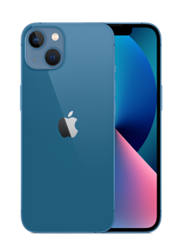
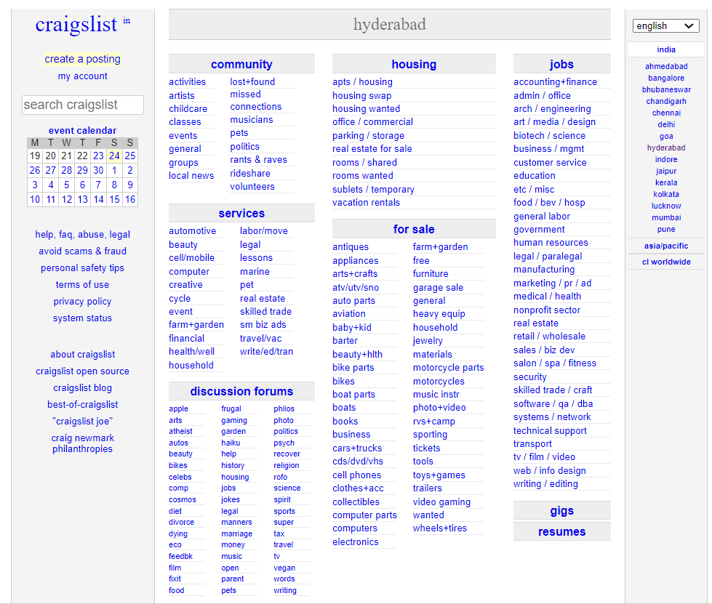

Product Appreciation Assignment
Ease of Use
Ergonomics
Aesthetics

Slide 92
Product Appreciation Assignment
1. iPhones are expensive
2. Few free apps and games in Apple store
3. Radio is not in-built
4. iPhone apps are usually big, consuming too much space.
5. Limited widgets even after upgrades on iPhone
6. Too simple and doesn’t support computer work as in other devices
7. Lack of Headphone Jack
8. Use of iTunes is a bloated mess.
9. Absence of physical back button
10. limited Launcher
11. Expensive Accessories.
12. No External Storage.
13. Overheating
14. Limited storage
15. Apple Ecosystem
16. Battery Life
17. Fewer choices in iPhone Hardware
18. A lightning cable charger is hard to find
19. No customization
20. No multitasking
21. No sideloading of Apps

Slide 93
Product Appreciation Assignment
There are many disadvantages of laptop computers, which are given below.
Durability
Sensitivity
Higher Cost
Health issues
Security Issue
Frequent Updates
Limited Battery Backup
Maintenance is Expensive

Slide 94
Product Appreciation Assignment
There are many disadvantages of laptop computers, which are given below.
Badly Designed
Not Detailed
Boring
No Pictures
Not Colourful
Not Secure
No Regional Languages

Slide 95
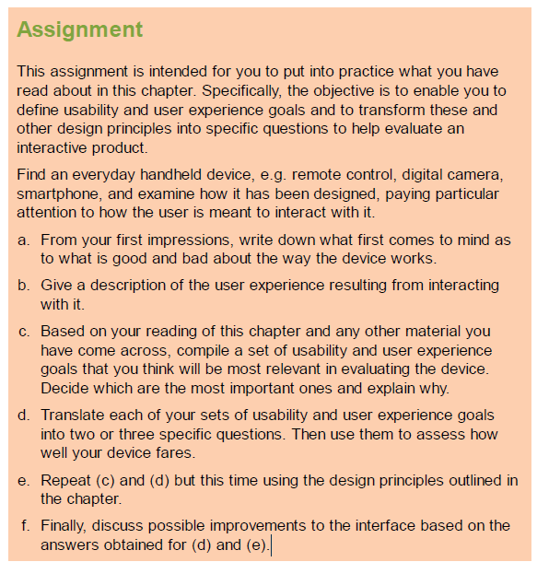
Assignment

Slide 96
WIT and WIL Scenario

Slide 97
Practice Questions

Slide 98
References

Slide 99
THANK YOU

